Slide 1
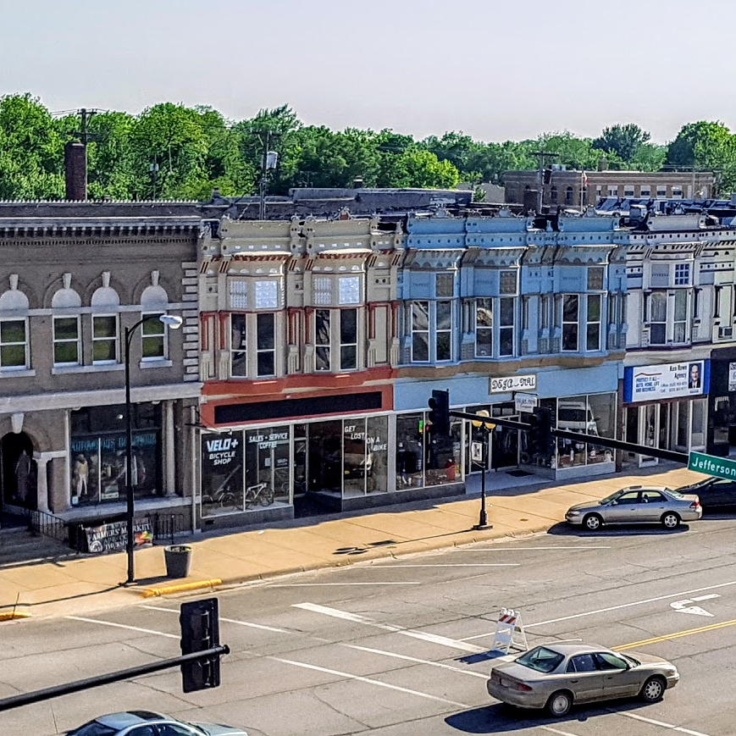
Allen county project pitch
Non-emergent transportation solutions for a Kansas rural community

Slide 2

Letter to the editor
Dear editor,
Something that bothers me is how older people can get free transportation but younger people don’t have those opportunities.
I have arthritis really bad in my knee and it takes all my energy to walk places. I am only 38 years old, but it’s hard.
Sometimes people like me who don’t have any means of transportation just don’t have the money to pay people to take us places.
I don’t know a lot of people in town so if I need to go somewhere to buy groceries or some other errand, I have to pay at least $10 a trip for someone from out of town to come and take me.
Iola needs to establish a means of free transportation for everyone. This morning I had to walk to Dollar General to get a few things which is about a mile from my house. My arthritis has been acting up a lot recently because of all of the rain. It took all my energy to walk out there and back home and now I am in a lot of pain.
Thank you,
Angela Stanley
Iola, Kan.
Sept. 3, 2019

Slide 3
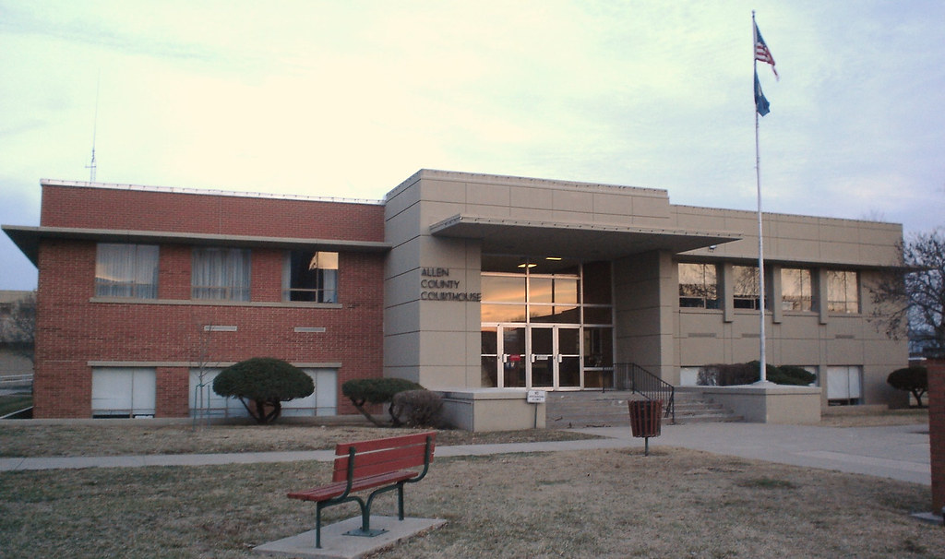
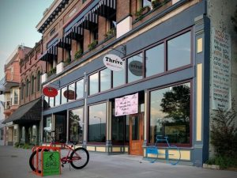
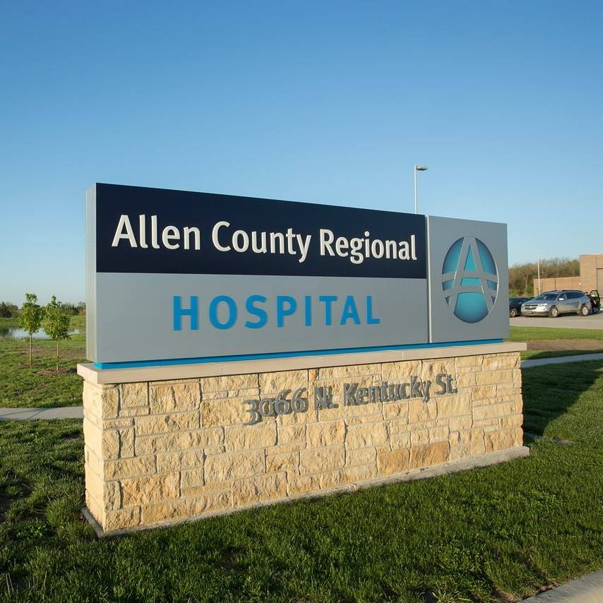
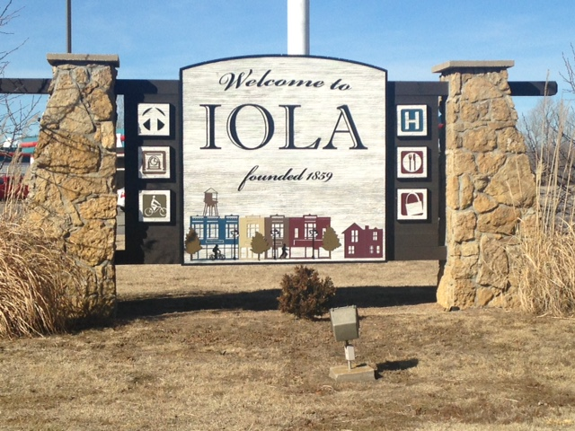
team
Allen county government
Thrive Allen county
Allen county rural health initiative
City of Iola
Includes:
Southeast Kansas Mental Health Center
Allen County Regional Hospital
Community Health Center of Southeast Kansas

Slide 4
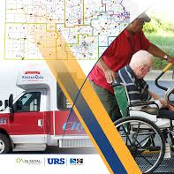
Focus question
How do we address transportation needs in Allen County, Kansas for patients with chronic physical and mental conditions?

Slide 5
KEY INSIGHTS
19% of Allen County residents are at or below FPL.
Lack of transportation creates a domino effect in the health and safety of residents.
Health care workers taking on transportation duties outside of their job.
Little flexibility in the system to reschedule missed appointments, particularly with specialists.
40% of cancelled outpatient surgeries at the hospital are due to transportation issues.
Patients experience anxiety and cascading health issues related to missed medical appointments.
Current transportation options in Allen County do not accommodate most patients’ needs.
20% of Allen County residents currently do not have reliable transportation options

Slide 6
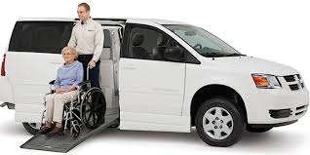
Design criteria
Reduces missed health care appointments in-county and out-of-county
Affordable
Flexible
Easy to Use
Relieves pressure from current medical staff
Reduces stress of patients
Available to all ages, mobilities, insurance types, and locations in county

Slide 7


concept
Allen County residents (pop. 12,519)
Adults 18-59 and families
Experiencing chronic conditions and mental health conditions
Unreliable transportation
Not able to utilize other forms of transportation assistance available
Flagship transportation
Deviated Fixed Route
Call Center to schedule trips
Online scheduling
Small vehicles to accommodate mobility issues
Available for medical and safety-net appointments
Provides transportation to appointments in-county and out-of-county
Available countywide
Housed by the county
customers

Slide 8

Business model
Charge fees for in-county and out-of-county trips
  $1-$2 for in-county
  Out-of-county fee structure based on distance. Capped at $50 for roundtrip.
Incentives
  Offer discounts to low-income households
  Vouchers for attending medical appointments
Apply for grant funding from Kansas Department of Transportation
Apply to be a registered vendor for Medicaid Reimbursement Transportation Services

Slide 9
Value
“How soon can this happen? I have several clients who are unable to get to medical appointments because of lack of transportation. They have missed appointments, been late on medication refills, skipped physical therapy appointments, etc. Because of this option, they would be more proactive than reactive when it comes to their health.”
Susan McMurtrey, Adult Case Manager
Southeast Kansas Mental Health Center

Slide 10
Thank you!
Jessica@thriveallencounty.org
http://thriveallencounty.org/

